Slide 1


Housing Prices in London and the UK
Ean Pfeiffer, David Rodriguez-Jenkins, Brock Saxen
Data Acquisition and Analytics
School of Technology & Computing (STC)

Slide 2
Agenda
Problem Statement
Approach
Technologies
Related Work
Data Cleaning
Findings
Conclusion
Future Work
Reference
Q&A

Slide 3
Problem Statement
Utilizing the free available UK housing datasets, we would like to explore and analyze housing prices in London and other areas. Ideally utilizing the technique and methods taught throughout the course

Slide 4
Approach
With the techniques we learned in class we performed the following : cleaned our datasets, created data frames, analyzed our data, and finally created plots and heatmaps to visualize our findings

Slide 5

Technologies
Pandas
NumPy
Matplotlib.pyplot
Geopy, Mpu, Folium

Slide 6
Pandas
Pandas is a fast, powerful, flexible and easy to use data analysis tool that works with Python.

Slide 7
Numpy
NumPy is a tool used to perform a wide variety of mathematical operations and calculations and works with Python.

Slide 8
Matplotlib.pyplot
Matplotlib.pyplot is great for creating plots and visualizing data. It works well with Pandas and NumPy.

Slide 9
Geopy, Mpu, and Folium
The Geopy library was utilized to apply latitude and longitude to UK London counties.
Mpu library provides mathematical functions, for this project it allowed us to calculate the distance between 2 locations with their latitude and longitude.
Folium library allowed us to create leaflet maps as well as allow us to build heatmaps!

Slide 10
Data Cleaning
We had to do some data cleaning to come up with data that was more directly comparable and to remove values that would skew our visualizations, such as NaN and duplicate values.

Slide 11
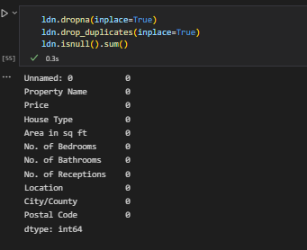
Data Cleaning
We used dropna(), drop duplicates(), and isnull() to help clean the data.

Slide 12
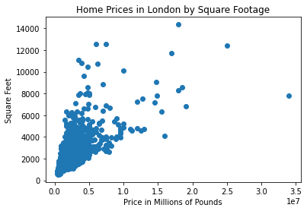
Findings
As we expected, home prices go up in proportion to square footage as well as with proximity to large cities. The average home price in London is £1.864.172, while the average home price in the UK is £328.828

Slide 13
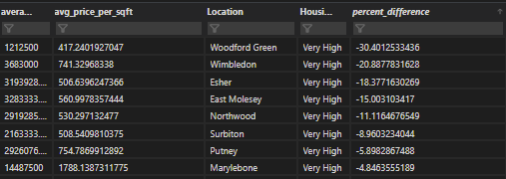
Findings contd.
We found that in some areas the price difference between houses labeled low square feet compared to house in the same area labeled very high square feet could have a up to a 30% discount per/sq ft. Shown in the table Woodford Green had a price difference of 30% as square footage rose.

Slide 14
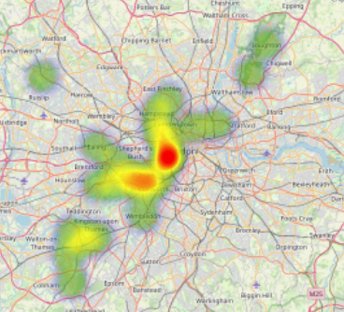
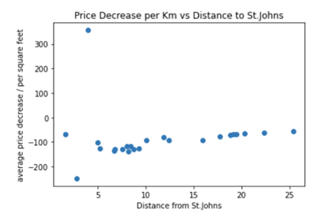
Findings contd.
As seen in the heatmap the West Minster area and Regent Park had the highest price/per sq ft. We also found that as you move 1km away from St.John's Woods you stood to have a decrease of 84.69 GBP per sq ft.

Slide 15
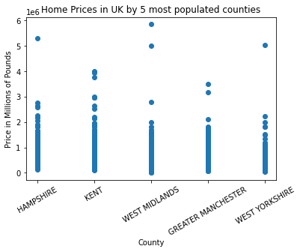
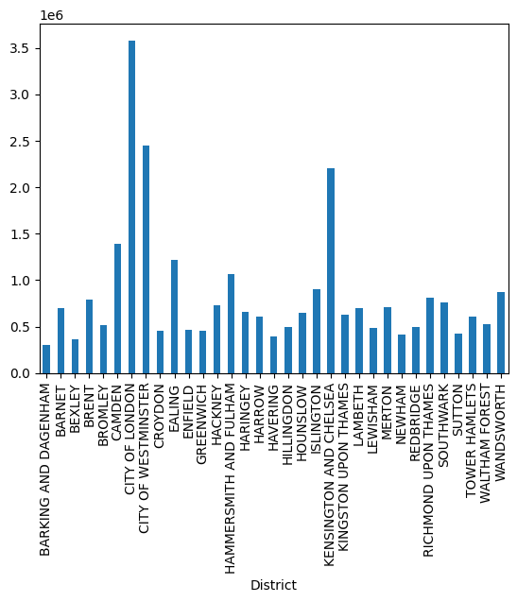
Findings contd.

Slide 16
Conclusion
Homes in metropolitan areas are much more expensive than the country as a whole, and there are a wide range of prices.

Slide 17
References
Fisher-Hickney, A. (2017). How to: Folium for maps, heatmaps & time data. Retrieved June 08, 2023 from https://www.kaggle.com/code/daveianhickey/how-to-folium-for maps-heatmaps-time-data/notebook
GeoPy Contributors. (n.d.). Welcome to GeoPy’s documentation! Welcome to GeoPy’s documentation! - GeoPy 2.3.0 documentation. https://geopy.readthedocs.io/en/stable/
HM LAND REGISTRY. (2020). UK Housing Prices Paid. Retrieved June 08, 2023 from https://www.kaggle.com/datasets/hm-land-registry/uk-housing-prices-paid
Hunter, J., Dale, D., Firing, E., Droettboom, M., & Matplotlib development team. (n.d.). Matplotlib 3.7.1 documentation#. Matplotlib documentation - Matplotlib 3.7.1 documentation. https://matplotlib.org/stable/
Kulkarni, A. (2020). Housing Prices in London. Retrieved June 08, 2023 from https://www.kaggle.com/datasets/arnavkulkarni/housing-prices-in-london.
Pandas. (n.d.). User guide#. User Guide - pandas 2.0.2 documentation. https://pandas.pydata.org/docs/user_guide/index.html
Martin Thoma, mpu, (2022), GitHub repository, Retrieved June 08, 2023 from https://github.com/MartinThoma/mpu

Slide 18


Q&A

